Slide 1
Quiz #1 overview
Quizzes to be handed back at the end of class today
Class average: 16.2/20 (81%)!
Answer key is available on canvas
If you have a question about grading or something marked incorrect
Check the answer key- do you understand the correct answer? Do you understand why your answer was marked incorrect?
If not, email me to set up a time to talk
**I can not answer questions on grading before steps 1 and 2 have been taken**

Slide 2
Upcoming assignment
Primary research article and workshop Monday 2/3
1st term project due next week 2/4:
Essay and graphical depiction of the pathway in which your cancer gene normally functions.
Requires a minimum of 4 primary research articles to be used and cited within your report.
Optional: If you have questions about whether the articles you have identified are primary research articles, please ask BEFORE the assignment is due!
Refer to the instructions and grading rubric for this assignment on canvas for further details

Slide 3
Growth Factors, Receptors, & Cancer
Chapter 5 objectives:
Be able to describe the chain of events that leads to tyrosine receptor ligand activation
Understand how arrows and lines are used to depict a proteins role in a pathway
Appreciate both the diversity of receptor signaling pathways, and the similarities they share with one-another
Begin to understand how activating mutations may be specifically targeted by therapeutic approaches

Slide 4
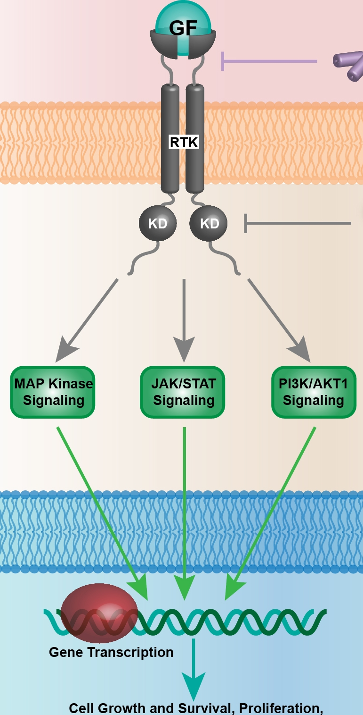
External signals regulate gene expression
1. Growth factor (GF) molecules bind a receptor on the cell surface (input)
Cell membrane
2. Cytoplasmic domain of the receptor initiates a signal cascade (processing)
cytoplasm
3. Signal is relayed across the nuclear membrane where transcription factors are activated (processing)
4. Genes are expressed that promote growth, survival, proliferation, etc (output)
Nuclear membrane
nucleoplasm

Slide 5
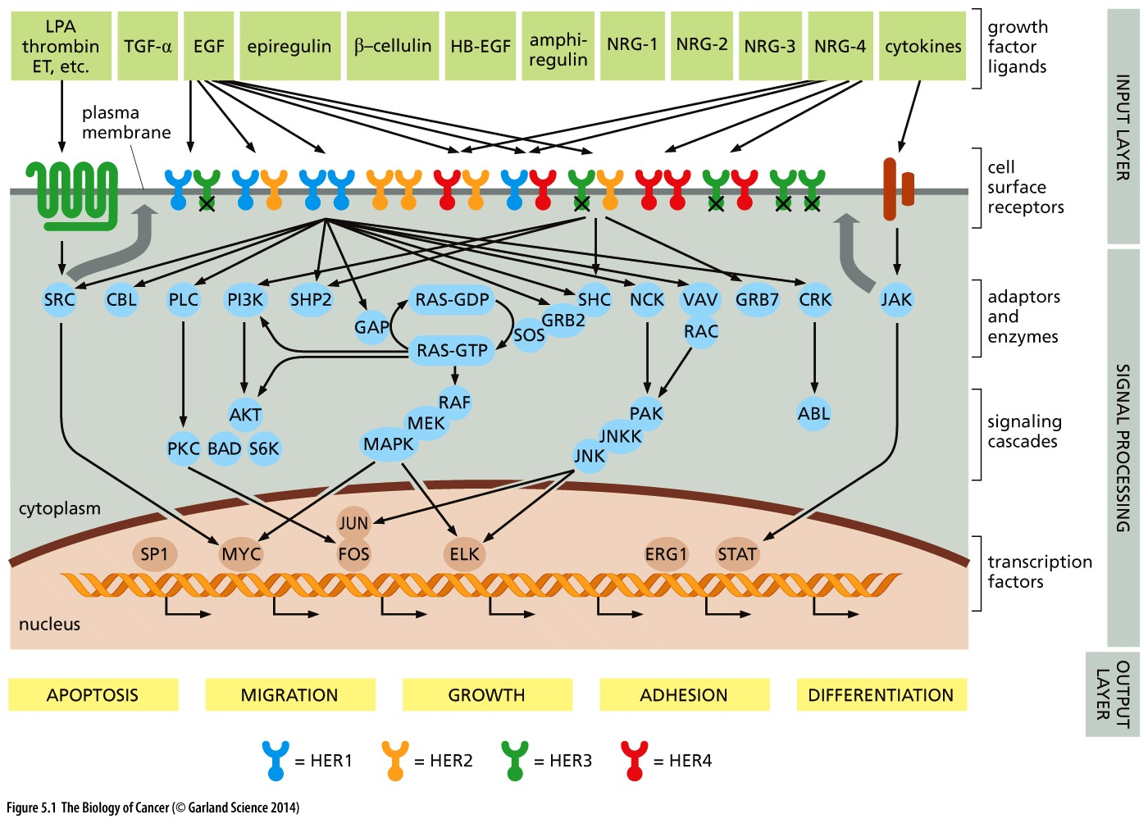
Growth factor signaling: the complexity
These are the pathways relevant to just one family of receptors called receptor tyrosine kinases

Slide 6
How might growth factor signaling be disrupted in cancer?
Bypass the input and make receptors active without growth factor!

Slide 7
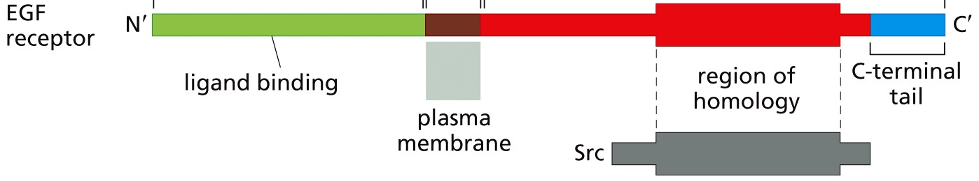
Dissecting receptor tyrosine kinases
Epidermal growth factor (EGF): small extracellular proteins that induce a growth stimulatory signal
EGF receptor (EGFR): is activated by binding of EGF
EGFR protein has 3 domains
Extracellular domain
Transmembrane domain
Intracellular (cytoplasmic domain)

Slide 8
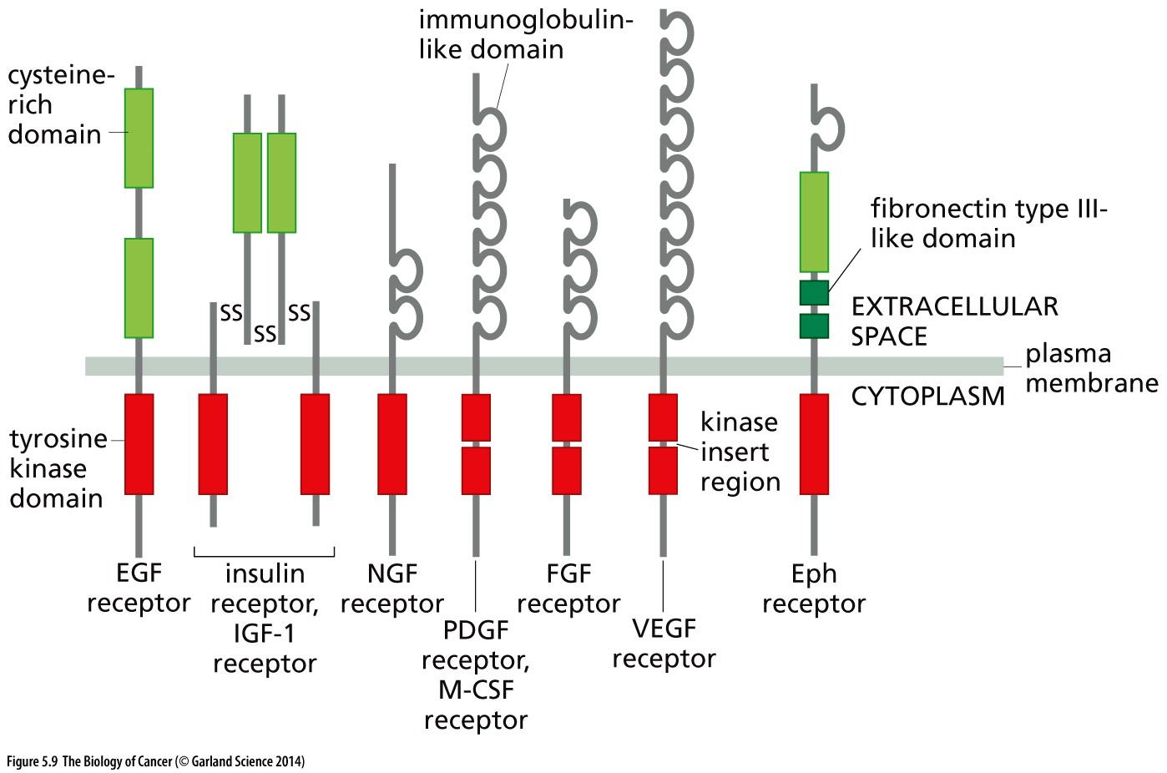
RTKS share homology
How does the membrane dictate the need for these receptors?
Homology to the viral oncogene Src
Src has kinase function

Slide 9
Why are receptors needed?
What does the membrane look like?
Lipid bilayer with a hydrophobic center
Cell membrane is impermeable to polypeptides and polar molecules (like most ligands)
→ receptors that span the membrane are required to transmit the ligand’s signal across the membrane!

Slide 10
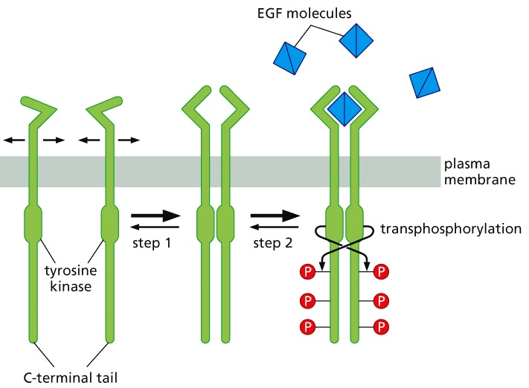
Autophosphorylation activates receptor tyrosine kinases
Inactive receptors are monomers
Active receptors are dimers
Homo or heterodimers
Binding of the growth factor promotes dimerization
Growth factor binds a receptor monomer
Lateral movement allows it to find its dimer
Receptor tyrosine kinase can now phosphorylate substrates
Including it’s own dimer
How is this movement possible?

Slide 11
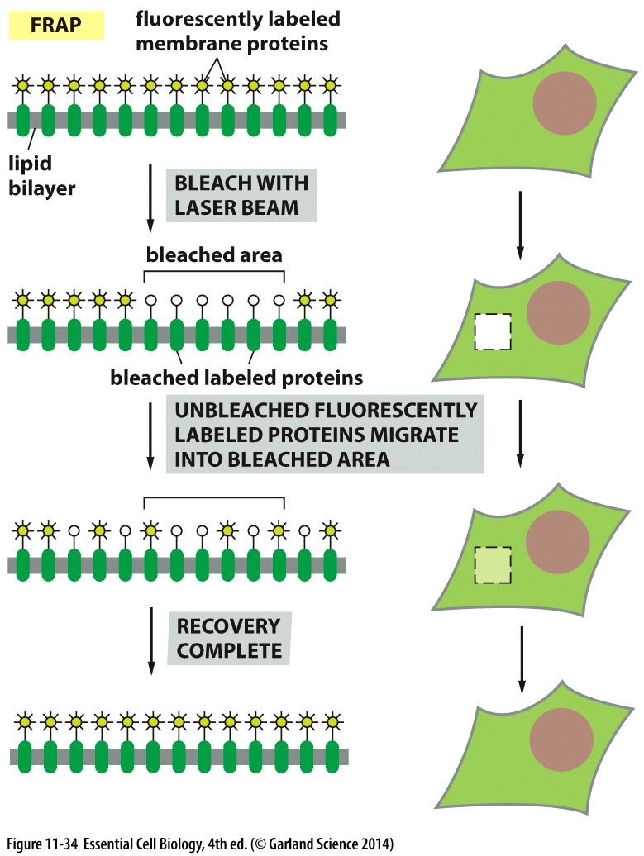
Life in the membrane
Can proteins move within the membrane?
How?
Most proteins can move freely in the plane of the membrane
Hydrophobic transmembrane region remains surrounded by hydrophobic lipids of the cell membrane
Fluorescence Recovery After Photobleaching to experimentally examine protein dynamics in a membrane

Slide 12
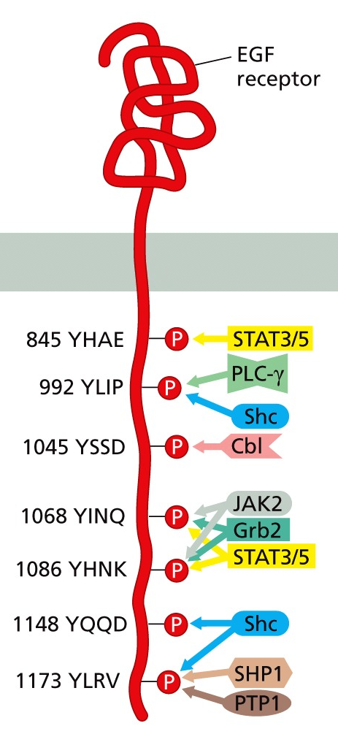
Biochemistry of cancer
How do TRKs find substrates?
TRK-s are stuck in the membrane
Substrates must come to them
Auto-phosphorylated sites serve as binding sites for kinase substrates with SH2 domains
Recruitment tool to re-localize Sh2-containing proteins to the cell membrane
propagate the signal by interacting with other signal transducing molecules (like other kinases)

Slide 13
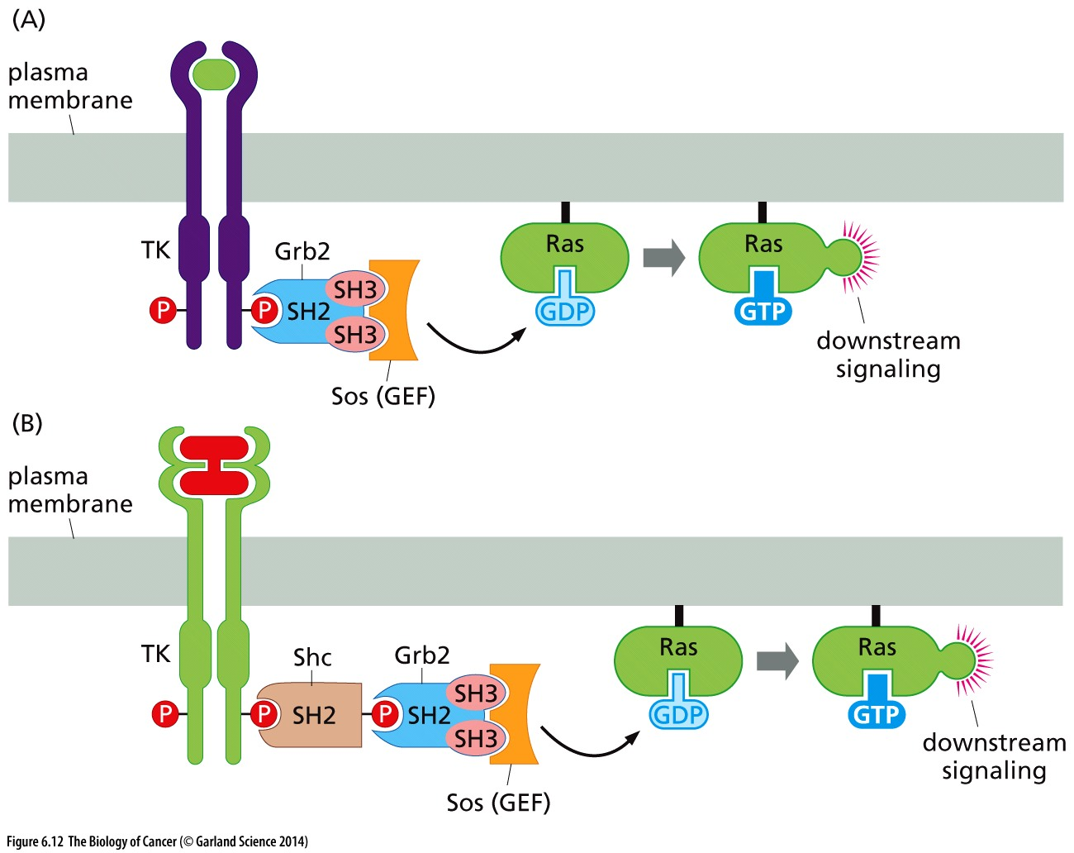
Trans-phosphorylation is key to initiating a signal cascade
EGFR receptor
Membrane-bound Ras protein
Binding to EGFR brings Grb2/Sos into the vicinity of the membrane (high localized concentration) to activate RAS
**Grb2 is just one of many SH2-containing proteins that bind EGFR**

Slide 14
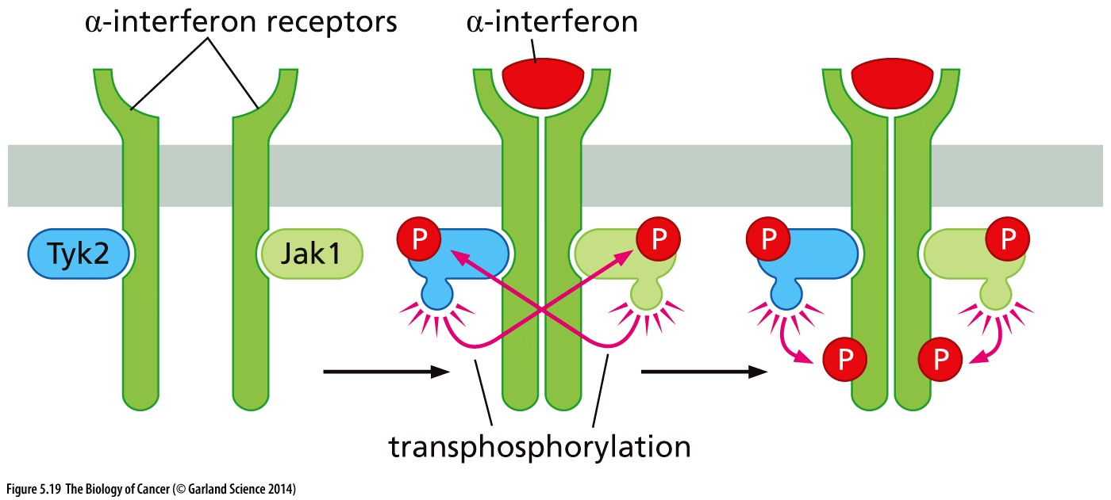
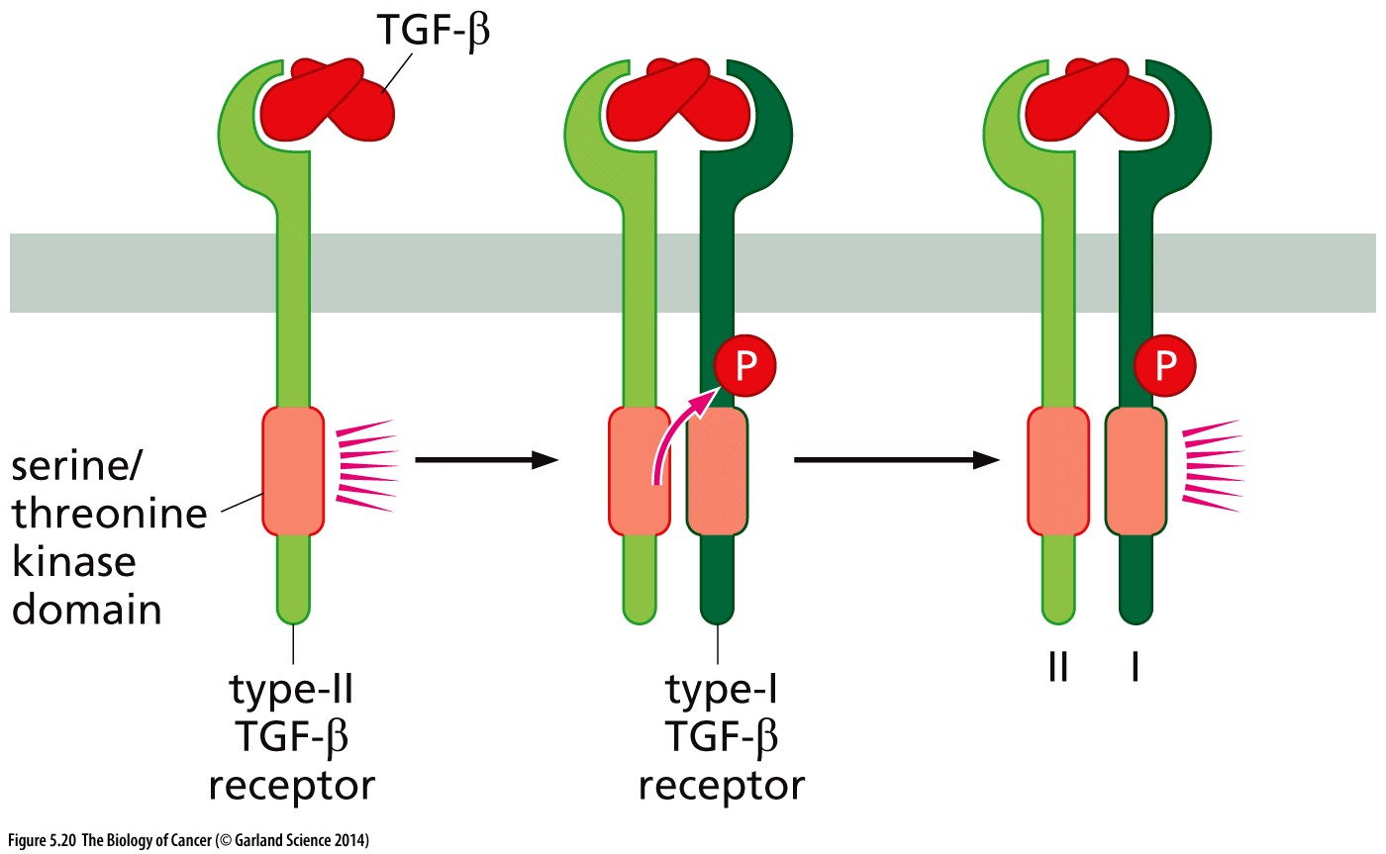
Variations on a theme
Similar regulation of Cytokine receptors and TGFβ receptors
Each receptor monomer is complexed with a tyrosine kinase
Ligand-induced dimerization promotes transphosphorylation and activation
Ligand binding promotes dimerization of two different receptors
Transphosphorylation on a serine/threonine residue promotes activity

Slide 15
Corrupting the pathway
How might a cancer cell bypass the regulation by growth factors and ‘skip ahead’ to improperly promote proliferation?

Slide 16
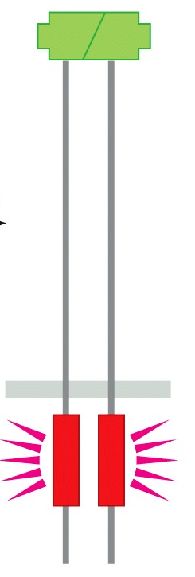
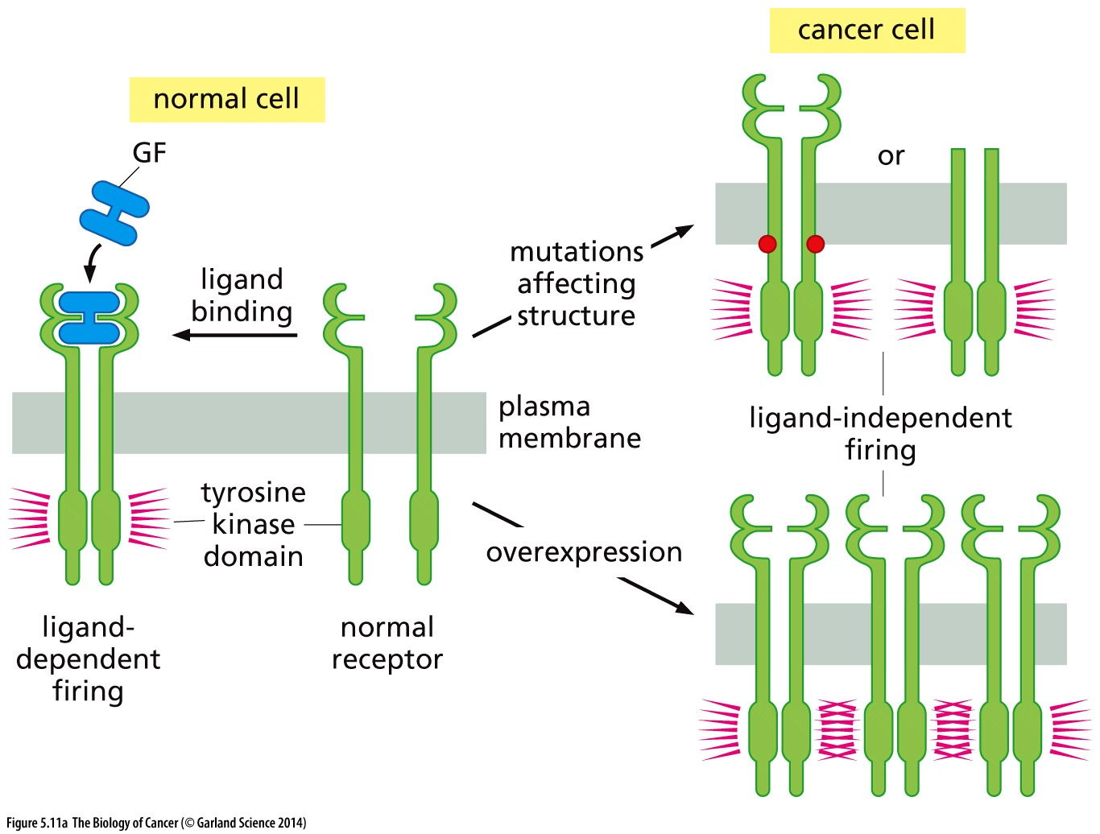
Trans-phosphorylation is key to initiating a signal cascade
How might a cancer cell bypass the regulation by growth factors and ‘skip ahead’ to improperly promote proliferation?
mutations to mimic auto-phosphorylation
Mutations/fusions to promote receptor dimerization
overexpression to enhance ‘accidental’ dimerization
Also inhibition of endocytic receptor recycling (ie stop removal of receptor)
Increased autocrine signaling (cell makes and excretes its own growth factor)

Slide 17
Secondary signaling by RTKs
EGFR receptor
Membrane-bound Ras protein
Normally Ras hydrolyzes the bound GTP → GDP and returns to an inactive state

Slide 18
Bypassing the need for RTKs
EGFR receptor
Membrane-bound Ras protein
X
Oncogenic Ras has a mutation in the GTPase domain
GTP doesn’t hydrolyze to GDP and Ras remains active

Slide 19
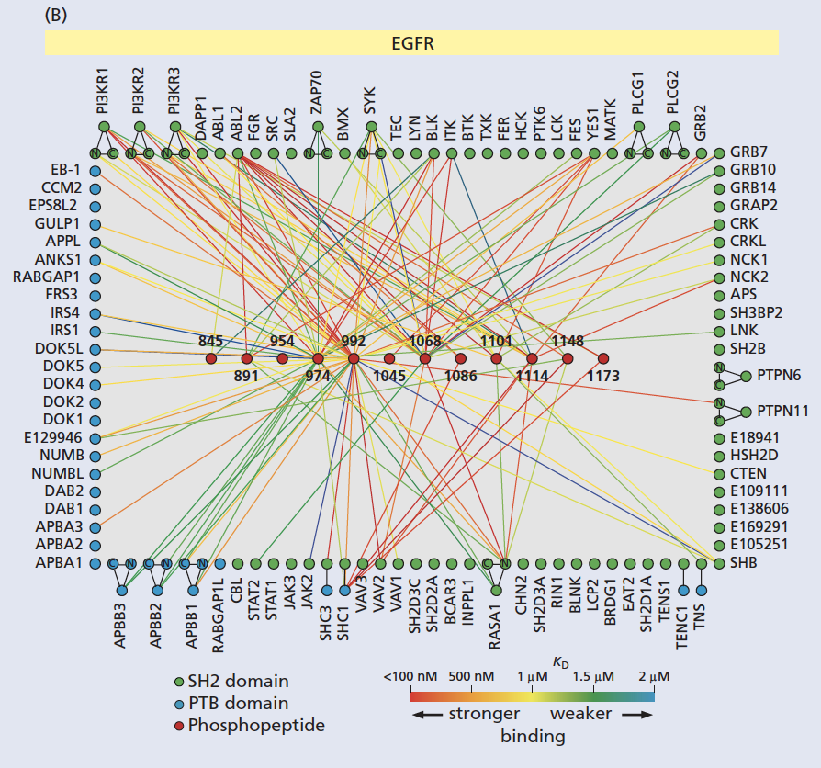
Many steps along the signal transduction pathway allow many opportunities to tweak the cell’s response
Different combinations of interactors/binding partners have different “outputs”
Not all disruptions in the pathway are identical…

Slide 20
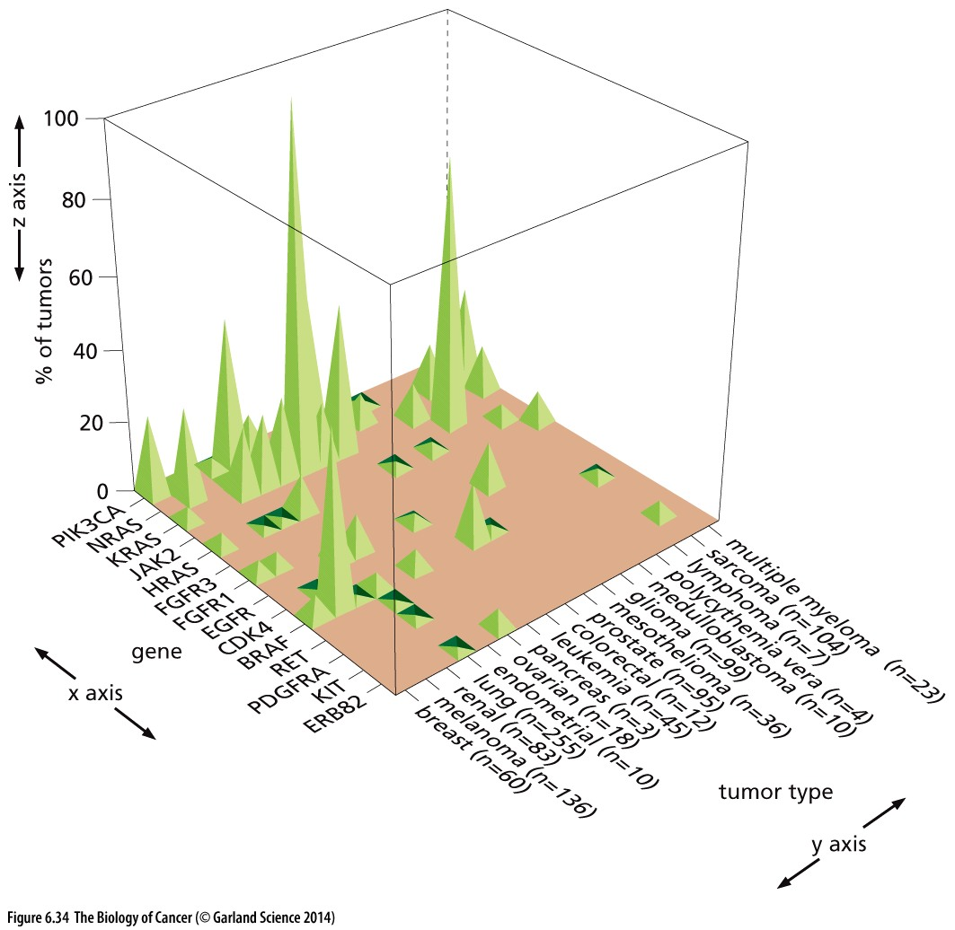
EGFR, BRAF, or RAS?
The manner in which growth signaling is altered is varied
Different genes are mutated in different cancer types
Explanation for such strong inter-tumor-type variations are lacking…

Slide 21
Tumor Suppressor Genes
Chapter 7 Objectives:
Be able to provide examples of how we know tumor suppressor function is recessive
Understand the term “loss of heterozygosity”, be able to provide an example of how LOH happens, and how it relates to tumor development

Slide 22
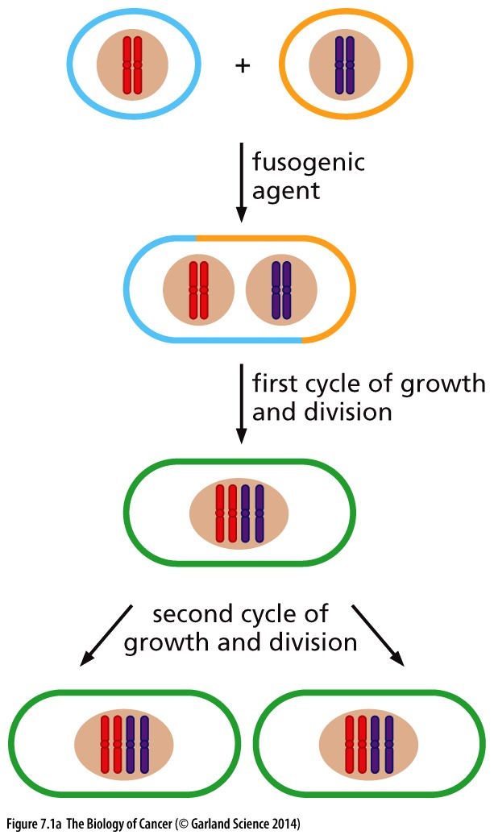
Recessive Nature of Cancer
Cell fusion experiments joined a normal cell with a cancer cell
If cancer-promoting lesions are dominant (like viral oncogenes), the hybrid will be tumorigenic
If cancer-promoting lesions are recessive, the hybrid will not be tumorigenic
Wild type genes antagonize the cancer phenotype
The cancer gene must be a negative regulator of proliferation → tumor suppressor

Slide 23
Recessive Nature of Cancer
Argument for:
Many many ways to inactivate a gene
Comparatively few ways to activate a gene (only specific mutations/fusions)
Argument against:
But chance mutations to BOTH copies of the same gene in the SAME cells is highly unlikely/would take several decades…

Slide 24
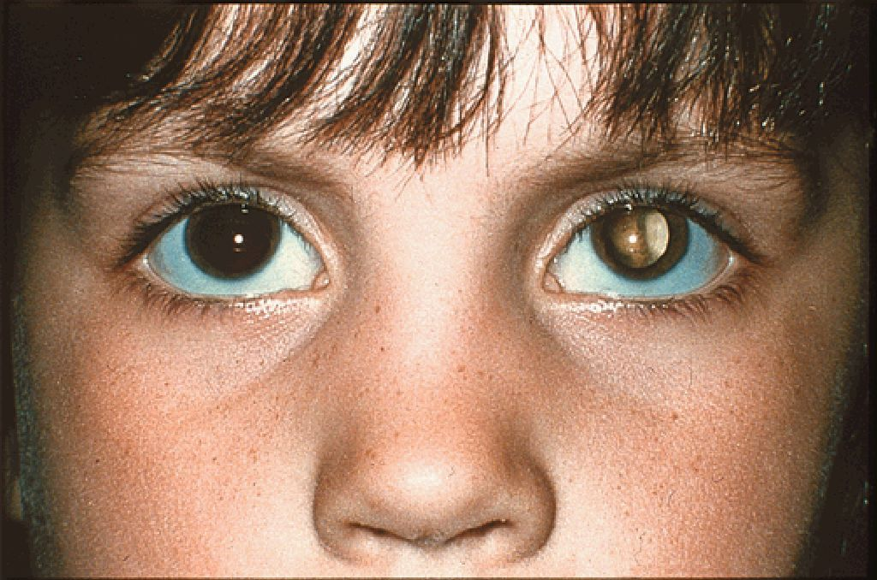
A rare disease yields insight into cancer genetics
Retinoblastoma
Develops from immature cells of the retina
Accounts for ~2% of childhood cancers (~200-300 children diagnosed each year)
½ are inherited (family history)
½ are sporadic
Inherited retinoblastoma is often bilateral (both eyes)
Sporadic retinoblastoma is unilateral (one eye)
Bilateral cases (hereditary) are diagnosed at 14-16mo, sporadic at nearly 24-30mo

Slide 25
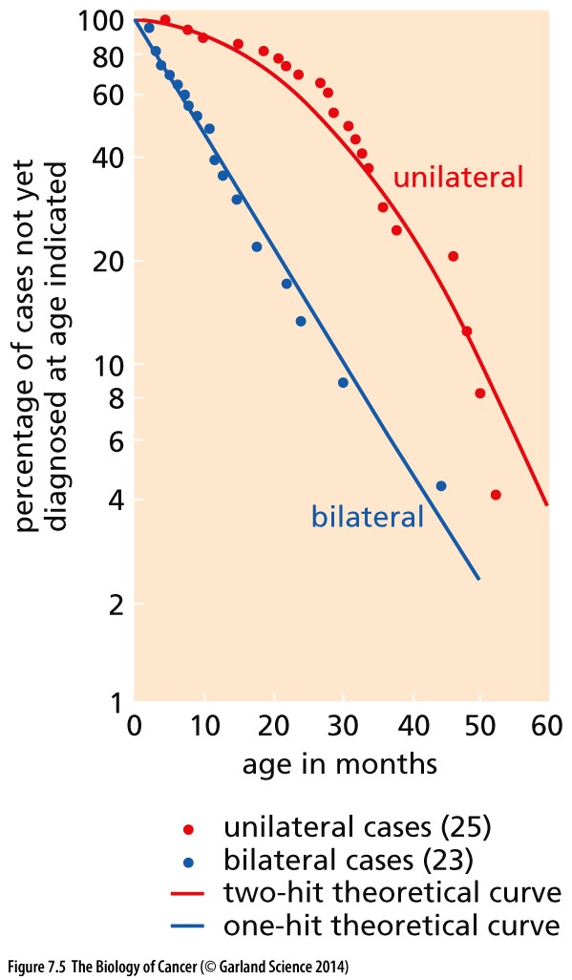
Genetics of a tumor suppressor
The kinetics of development of unilateral vs bilateral retinoblastoma suggested a “two hit” hypothesis for unilateral cases
i.e. two somatic mutations were required for unilateral retinoblastoma
This hypothesis didn’t require that both mutations be in the same gene
we now know it is mutation to both copies of the RB1 gene that is limiting for retinoblastoma

Slide 26
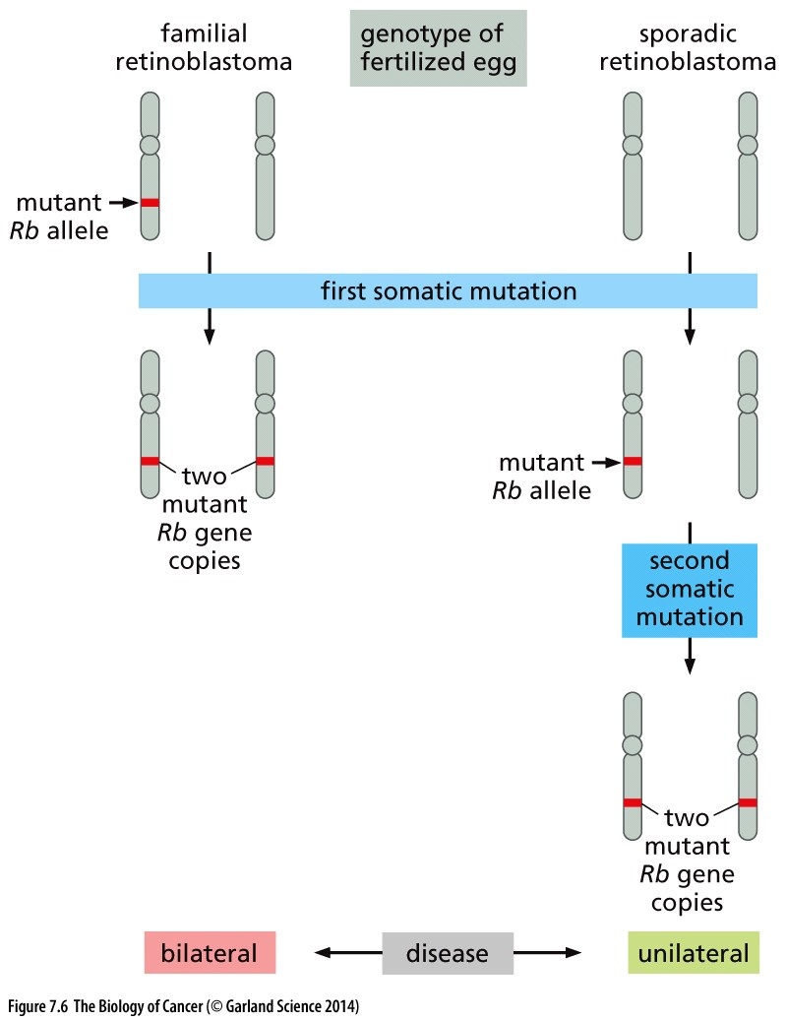
Dynamics of retinoblastoma
Sporadic retinoblastoma
Only one/few cells have an Rb mutation
A second mutation must occur in the same cell to cause retinoblastoma
Inherited retinoblastoma
All cells in the body have a single Rb mutation
A second mutation in Rb in any retinal cell can cause retinoblastoma

Slide 27
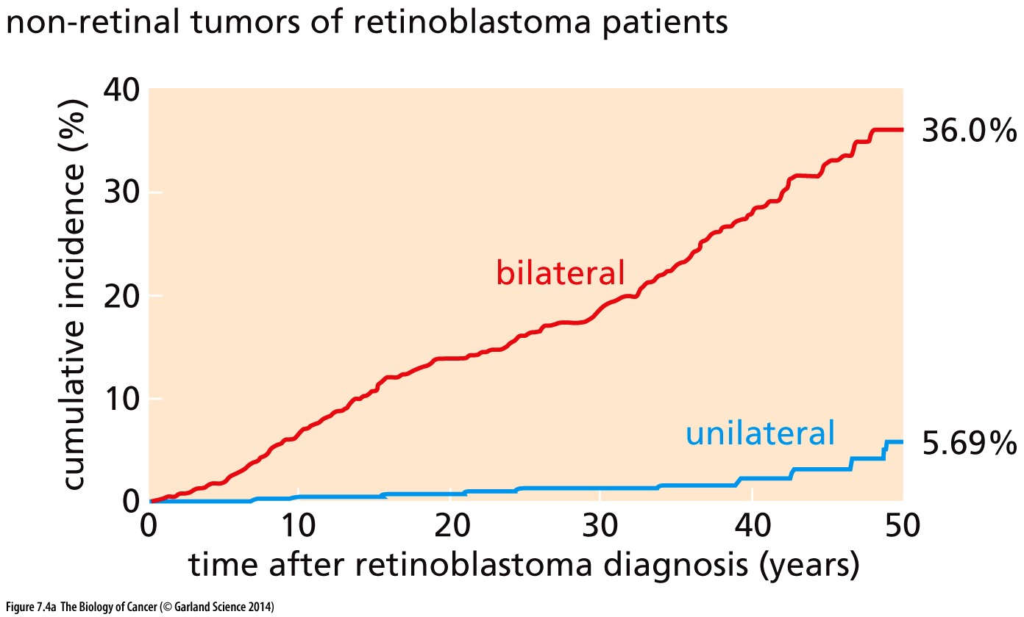
tumor suppressor function is conserved
Hereditary Rb: all cells of the body have one ‘bad’ copy of RB1
Mutation of the ‘good’ copy in other cell types causes cancer

